Slide 1
Agar.io
數位多媒體整合設計
10250601 林 忻

Slide 2
About
Agar.io is a web browser-based game where the player must increase the size of of their own circular cell by engulfing other player’s cells.
The game is notable for its simple addictive gameplay. It gets its name from Agar, a substance found in cell walls of certain algae.
Agar.io

Slide 3
History
The Java script-based game was originally created by a user of 4chan’s (Video Games) board and launched under the domain name Agar.io per another anonymous poster’s suggeston on April 28th, 2015. On the day of its launch, the game began attracting massive attention after it was linked on 4chan. On May 3rd, the game was submitted to Steam Greenlight, where it was promptly approved.
Agar.io

Slide 4
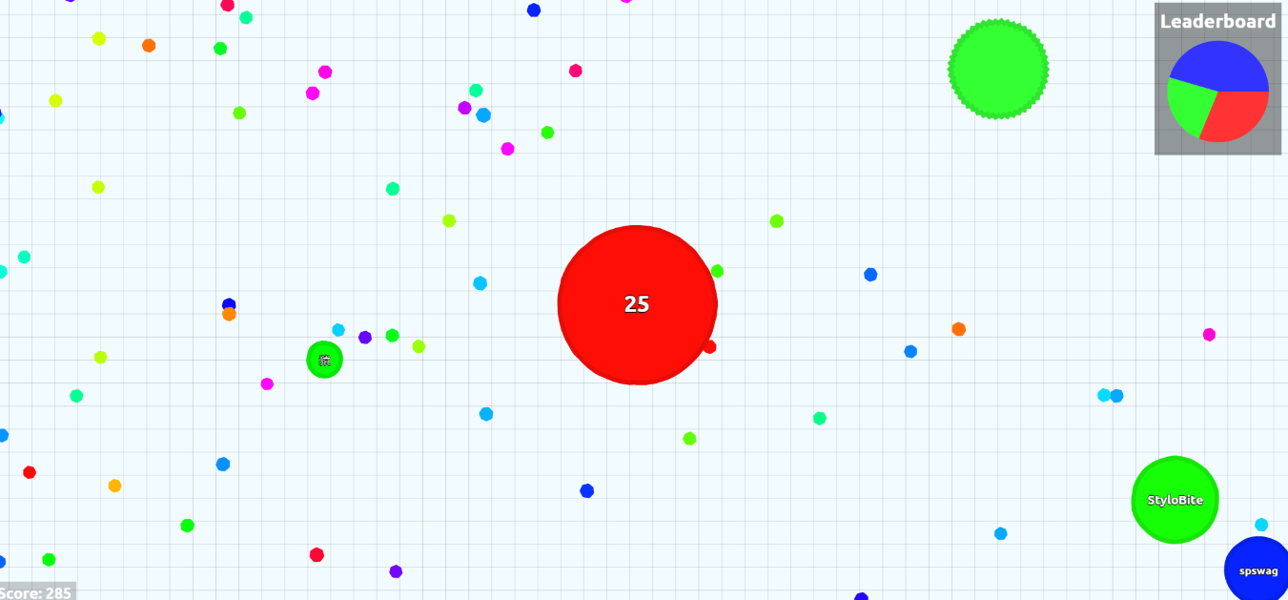
http://agar.io/

