Slide 1
Mid-Term Report
Department of Graphic Communication Arts
Name：Wu Chao Chao
ID：10250811

Slide 3
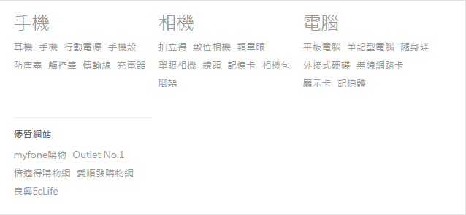

Slide 4
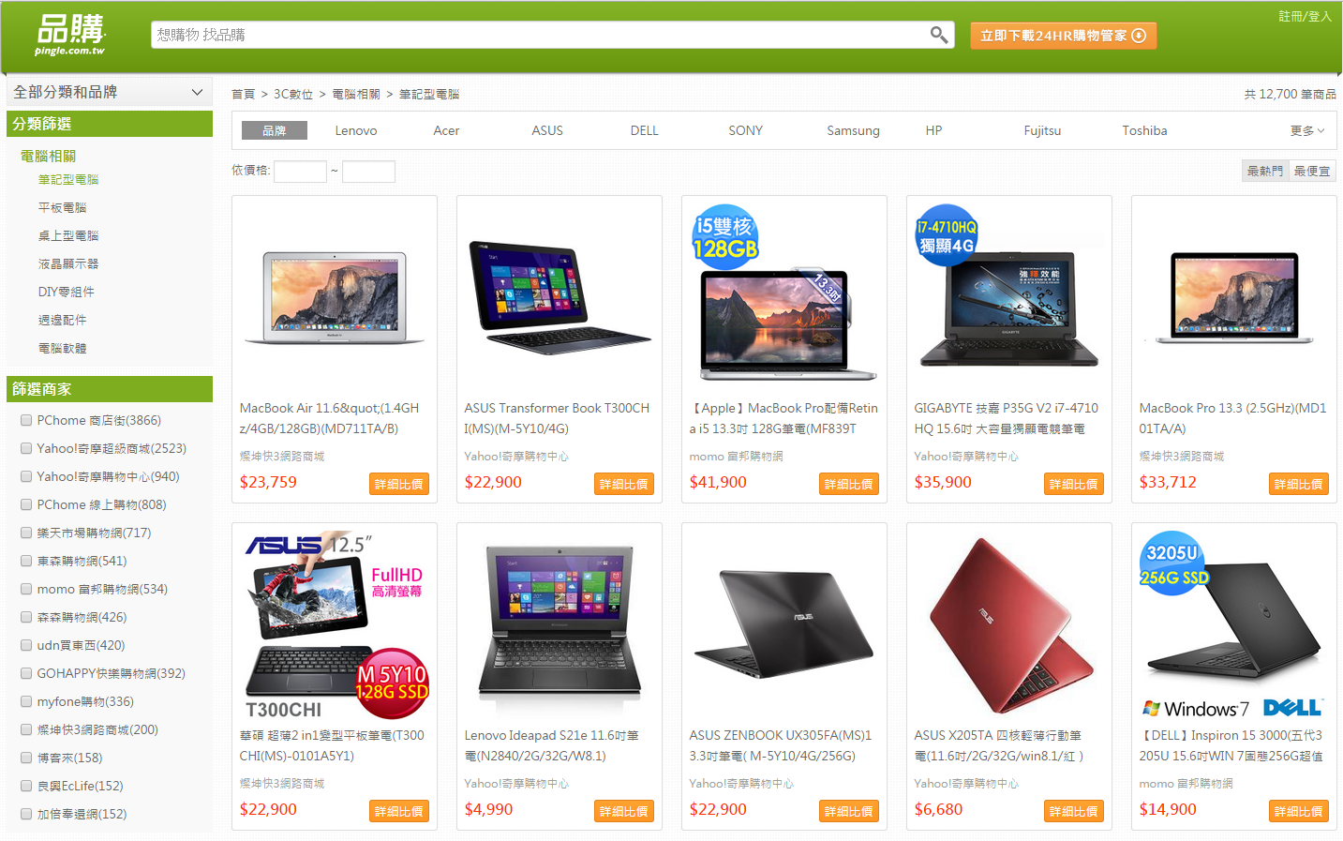

Slide 5
客服

Slide 6
